Slide 1
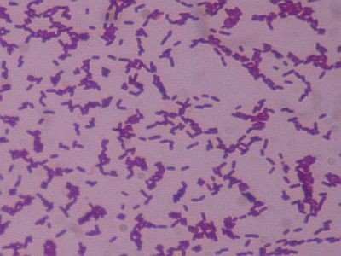
Listeria
Members of the genus Listeria are G+, non-spore forming, facultatively anaerobic rods. L. Monocytogenes are small coccoid rods that frequently occurs in chains. L. monocytogenes is an important causative agent of wide spectrum of disease in human & animals.
Morphology & identification:
Is a short G+ rods. It has a tumbling end-over-end motility at 22 C, but not at 37 C. facultative anaerobe, catalase +.
The natural habitat is decomposing plant matter as saprophytics
Culture & growth :
Listeria grow on media e.g. Muller-Hinton agar. On blood agar (sheep RBCs) small zone of hemolysis may be observed.
Pathogenesis:
L. monocytogenes enters the body through the GIT with the contaminated food e.g. Cheese or vegetables. enters the epithelial cells and start to produce lysteriolysin O which facilitate the spread of bacteria from one cell to another without being exposed to antibodies, complements or phagocytic cells.

Slide 2
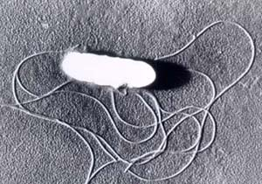
Disease, Epidemiology & pathogenesis
listeriosis, a serious infection caused by eating food contaminated with the bacteria. it has been recognized as an important public health problem. The disease affects primarily pregnant women, newborns, & adults with weakened immune systems. The two main clinical manifestations are sepsis & meningitis. Meningitis is often complicated by encephalitis, a pathology that is unusual for bacterial infections.
Flagella are produced at room temperature but not at 37°C. Hemolytic activity on blood agar has been used as a marker to distinguish Listeria monocytogenes among other Listeria species.
Listeria is associated almost exclusively with infections in animals, and less frequently in humans. However, listeriae, including L. monocytogenes are now recognized to be widely distributed in Nature. In addition to humans, at least 42 species of wild & domestic mammals & 17 avian species. L. monocytogenes is reportedly carried in the intestinal tract of 5-10% of the human population without any apparent symptoms of disease.

Slide 3
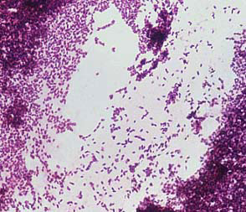
Disease & pathogenesis
L. monocytogenes causes listeriosis in animals and humans; L. ivanovii causes the disease in animals only, mainly sheep. Encephalitis is the most common form of the disease in ruminant animals. In young animals, visceral or septicemic infections often occur. Intra-uterine infection of the fetus via the placenta frequently results in abortion in sheep and cattle.
Pathogenesis :
L. monocytogenes is ingested with raw, contaminated food. An invasin secreted by the pathogenic bacteria enables the listeriae to penetrate host cells of the epithelial lining. The bacterium is widely distributed so this event may occur frequently. Normally, the immune system eliminates the infection before it spreads. However, if the immune system is compromised, systemic disease may develop. L. monocytogenes multiplies not only extracellularly but also intracellularly, within macrophages after phagocytosis, or within parenchymal cells which are entered by induced phagocytosis

Slide 4
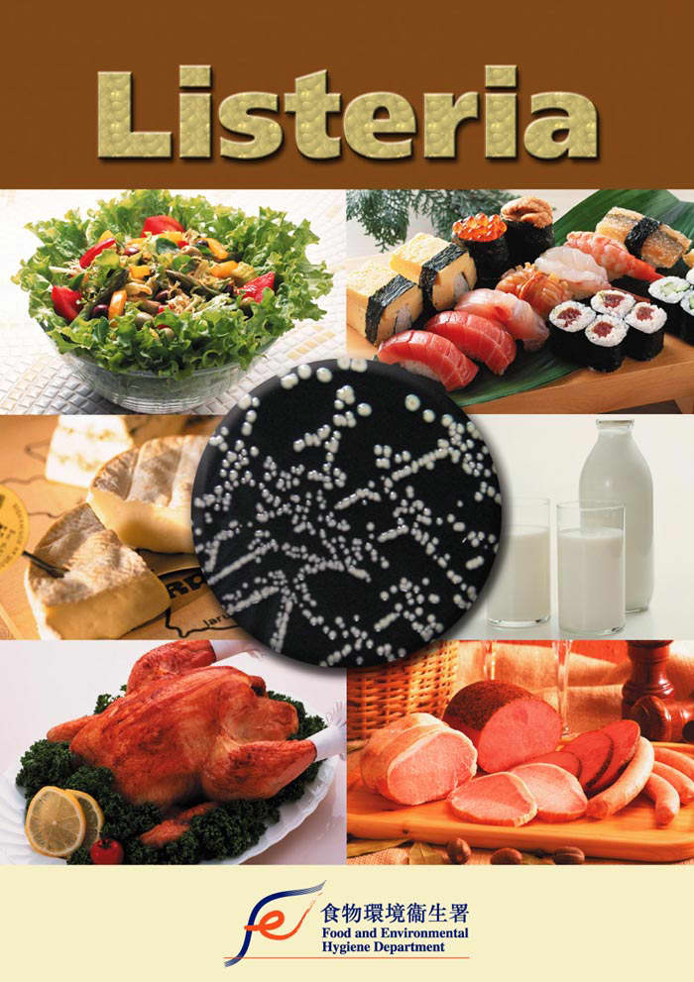
Pathogenesis Virulence factors
Virulence Factors:
Growth at low temperatures : A noval property of L. monocytogenes that affects its food-borne transmission is the ability to multiply at low temperatures (4⁰C ), So listeriosis is usually associated with ingestion of milk, meat or vegetable products.
Motility: like V. cholerae, Listeria, which is also acquired by ingestion are attach to the intestinal mucosa. although Listeria are actively motile by means of peritrichous flagella at room temperature (20-25°C), the organisms do not synthesize flagella at body temperatures (37°C).
Adhesion:
Listeria can attach to and enter mammalian cells. The bacterium is thought to attach to epithelial cells of the GI tract The bacteria then taken up by induced phagocytosis. After engulfment, the bacterium may escape from the phagosome before phagolysosome fusion occurs mediated by a toxin, which also acts as a hemolysin, listeriolysin O (LLO). Survival of the bacterium within the phagolysosome also occurs, aided by the bacterium's ability to produce catalase and superoxide dismutase which neutralize the effects of the phagocytic oxidative burst

Slide 5
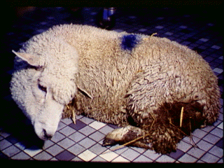
Listeriosis in animals
In animals; the disease is usually sporadic, but can occur as farm outbreaks in ruminants.
Three main forms are usually recognized throughout the affected species:
- encephalitis, the most common form in ruminants
- late abortion
gastro-intestinal septicemia with liver damage, in monogastric species as well as in preruminant calves and lambs
The causative bacterium lives in the soil and in poorly made silage and is acquired by ingestion. It is not contagious; Moreover, in Iceland, the disease is called "silage sickness“.
In sheep, the disease is also called the "circling disease“. The most obvious signs for the veterinarians are neurological, especially lateral deviation of the neck and head.

Slide 6
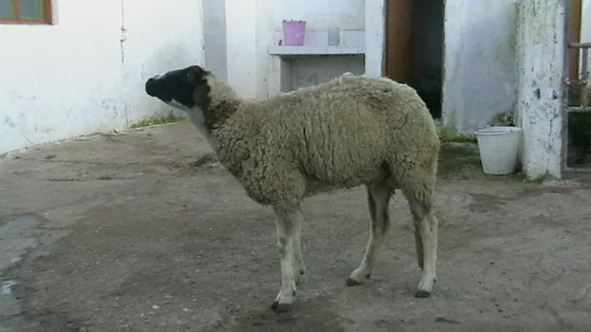
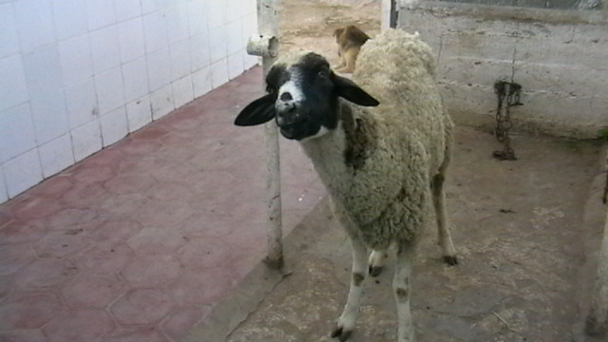
Listeriosis in animals

